Slide 3
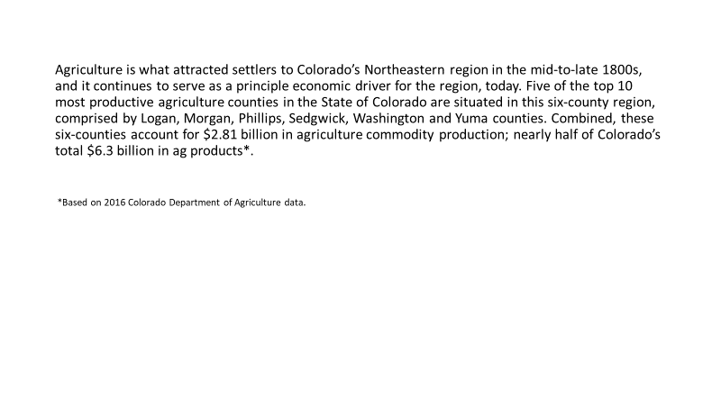

Slide 6
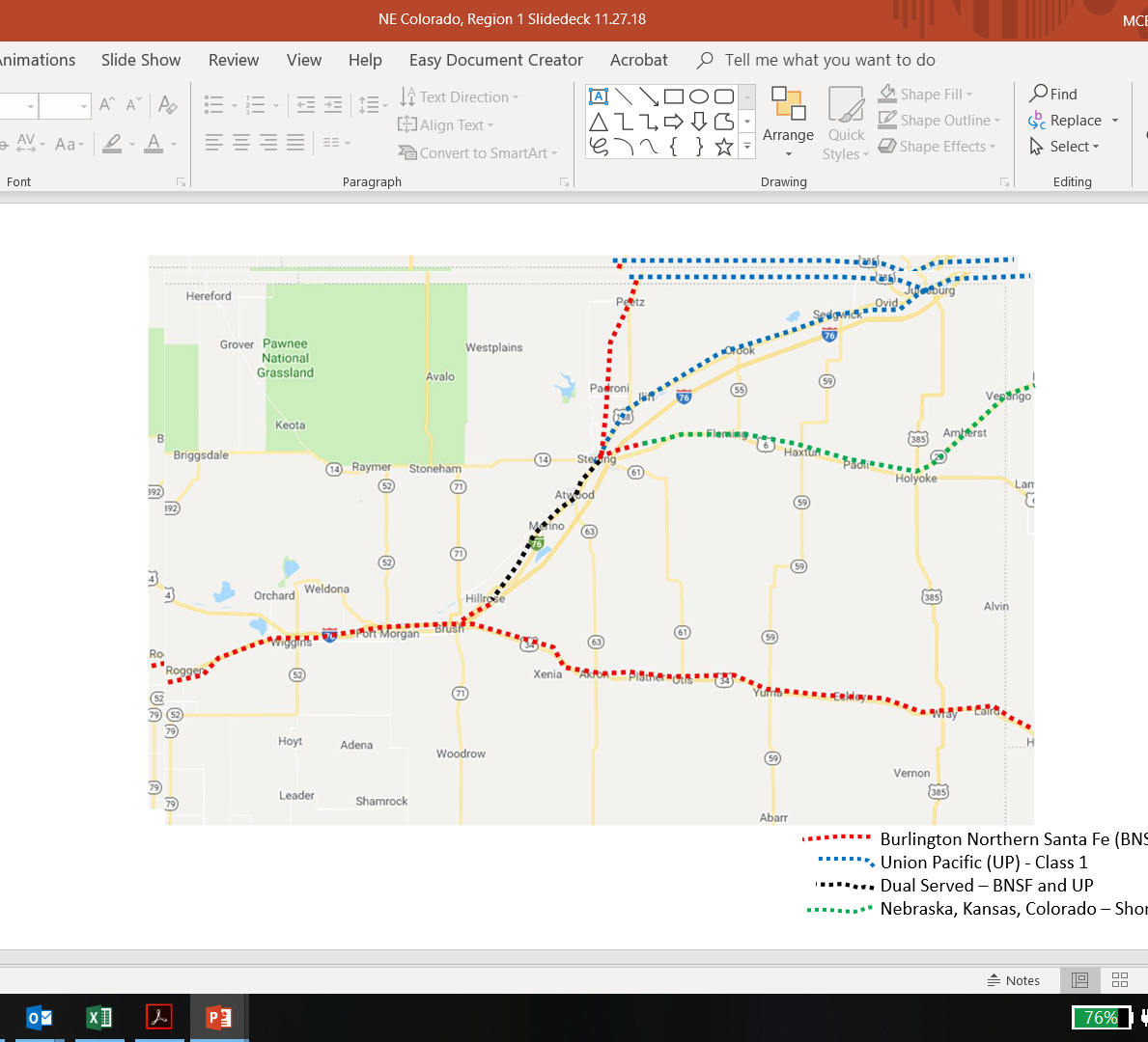

Slide 7
Sedgwick County Economic Development

Slide 8
GrowNEColo.info

