Slide 1



Slide 2


What is a census?
A count of all persons living in the United States on April 1st conducted every 10 years
Census Day is April 1, 2020

Slide 3


It’s Important
Census counts influence representation by determining:
  The number of seats each state has in the US House of Representatives.
  How state house and senate districts are redrawn.
  County Commissioner and City Council Districts

Slide 4
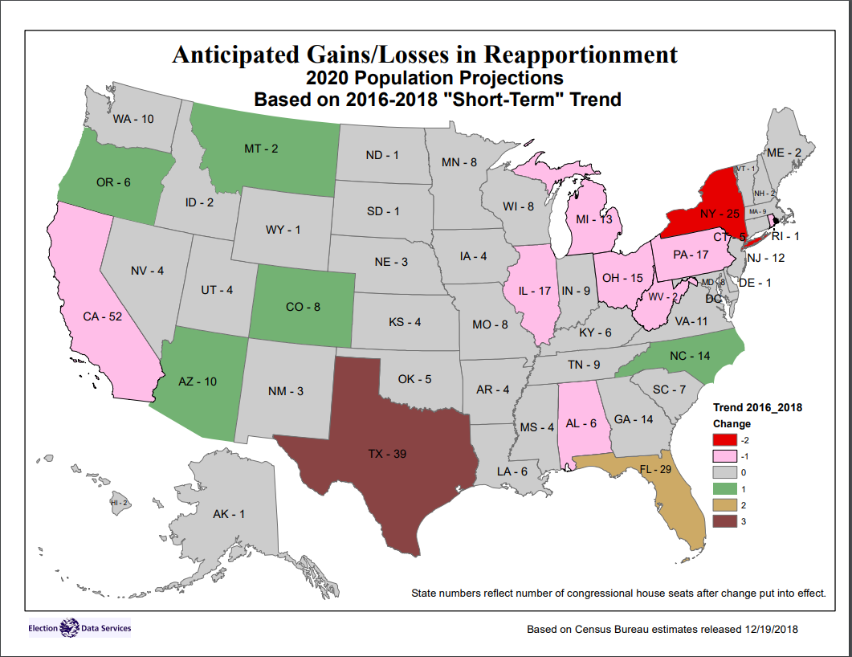
Reapportionment - Projection
Source: Election Data Services Inc. December 19, 2018
Notes:
Reapportionment is the process re-distributing seats in the House of Representatives, or other legislative body, according to the population in each state. This example of reapportionment is actually done through a complex mathematical formula that ensures the most even distribution of House seats. While each state gets two seats in the U.S. Senate, each state is given a certain number of House seats based on its population; and every state is guaranteed at least one seat by the constitution, regardless of how many people live in that state.

Slide 5
It’s Important
Colorado receives ~$2,300/person per year, or over $13 billion annually for programs like:
Senior Services
Health Services
Public Housing (Section 8)
Public Assistance (SNAP)
Women, Infants, & Children (WIC)
Education
School Lunch
Road Improvements
Programs for Veterans
Community Colleges
Tuition Assistance
Health Centers
Public Libraries
Community Centers
Notes:
All direct distributions.

Slide 6

It’s Important
Census data is used for planning, program evaluation, business analysis, and service provision.
Used as a base population for the next 10 years.

Slide 7

Importance of the Census To Businesses
Businesses depend heavily in Census data and in understanding how to reach and how to communicate with customers and employees
Characteristics of your clients
Best areas to advertise

Slide 8
Count Everyone Once, and Only Once, In the Right Place.
Housing units /addresses are used as the foundation for the population count
Census form information will be sent to households using the Master Address File
Importance of having all housing units in list
Importance of having boundaries updated

Slide 9





It’s Easy
11 Questions
4 Ways to Respond
  Online
  By Phone
  By Mail-in Form
  In-person, Through an Enumerator
13 Languages
English, Spanish, Chinese, Vietnamese, Korean, Russian, Arabic, French, Tagalog, Polish, Haitian Creole, Portuguese, and Japanese

Slide 10
Census 2020 Questions
11 questions directed to the householder and to each person living in a household.
Name
Phone Number – Just for Census use if necessary.
Age
Citizenship – (pending)
Hispanic Origin
Race
Relationship to householder
Sex
Tenure – own/rent
Number of persons in household
Does the person usually stay or live somewhere else?

Slide 11

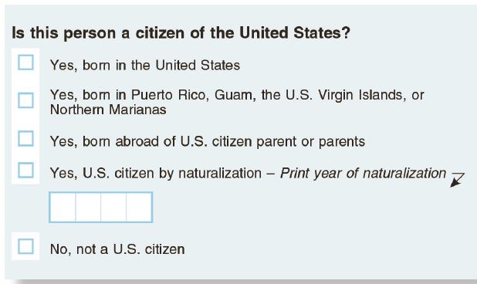
Citizenship Question
The proposed citizenship question asks whether a respondent is a citizen by birth or by naturalization. There are no attempts to identify respondents by their legal status.
Several court cases are challenging the inclusion of this question
District courts in New York, California and Maryland have rejected inclusion of this question
These decisions have been challenged by the Department of Justice and will be taken up by the Supreme Court in its April Docket
Decision must be made by June 2019 when the census form goes to print

Slide 12
Its Easy
Every household will be mailed an invitation to answer the Census.
People can respond to the Census online or request a paper form or call a phone number to respond.
Household will be mailed reminder cards up to 3 times if they don’t respond to the Census.
If they still don’t respond, households are visited by a census enumerator during “Nonresponse Follow-Up”
There are special plans for counting people experiencing homelessness, institutionalized persons, and college students.

Slide 13
Special Populations
Colleges/Universities
    Count students at the schools if that is where they normally live.
    Students in dorms are part of dorm count – will be counted by university/college
    Students off campus should be counted in the housing unit.
Prisoners - counted by the prison.
Homeless and transient locations – March 30th – April 1 by census takers at service providers or transient locations.
Homes in non-addressed areas – Update and leave
    Census taker will verify addresses and leave a questionnaire at housing units that have been identified as not having a traditional mail address. These are about 5% of the housing units across the US
    https://www.census.gov/newsroom/press-releases/2019/tea-viewer.html

Slide 14
Will a Census Enumerator come to my house?
In most cases, no.
  The census data collection process includes five contact opportunities before in-person enumeration begins
  A census enumerator will visit households that do not respond to contact requests
  Submitting the census form in online, over the phone, or on paper will prevent in-person enumeration
  Census Bureau administers several surveys – you may be contacted for other surveys

Slide 15

It’s Safe
  All data are protected and records are confidential for 72 years under federal law.
  Census will never share individual information with other government agencies.
  All Census Bureau employees swear a lifetime oath to protect information.

Slide 16
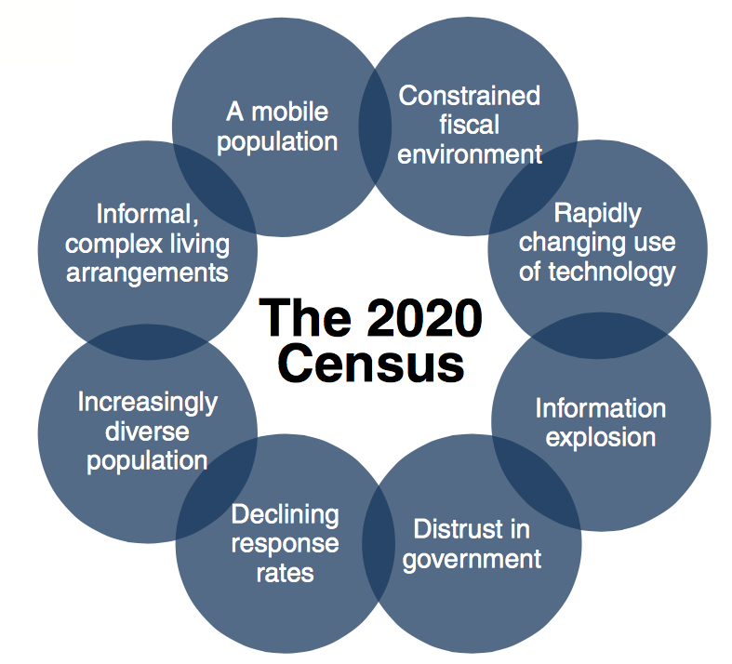
Challenges to a Successful Census
Notes:
Census
Fewer and Reorganized Regional Offices
Fewer Local Offices
Lack of full end-to-end testing
Final Questionnaire design pending
Funding
Lack of trust, people over surveyed.
State
Hard to Count Population – young, renters, low
Growth since 2010
Turnover in organizations who have worked on Census
Lack of trust, people over surveyed.

Slide 17
Harder to Survey Populations
Young children
Highly mobile persons
Persons with complex living arrangements or crowded housing
Racial and ethnic minorities
Non-English speakers
Low income persons
Persons experiencing homelessness
Undocumented (and documented) immigrants
Persons not living in traditional housing

Slide 18

How Will This Work?
Federal State Local Community

Slide 19
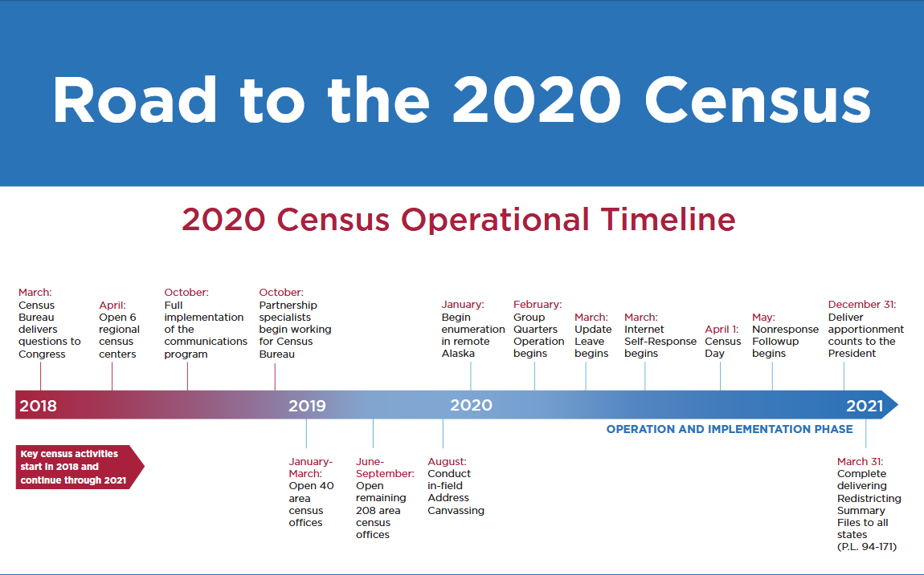



Slide 20
What is the State Demography Office’s and Dola’s Role?
Collaborate and support the Census Bureau
Collaborate and support local governments and organizations.
Updating the Master Address File for all housing.
Update the list of all Group Quarter facilities (prisons, nursing homes, college dorms)
Updating all boundaries – precincts, census tracts, census block groups, and municipal boundaries.
Leverage ideas from around state and nation
State Complete Count Campaign - staffing

Slide 21
State Complete Count Campaign
Goal: The Colorado Complete Count Campaign (CCC) is a volunteer committee established to increase awareness about Census 2020 and to motivate residents in the community to respond with the result of the best, most accurate, count in Colorado.
  Members Include:
  State Agencies
  Regional and local governments across state
  Non-profits – kids, immigrants, minority, wide networks
  Business community.
Subcommittees:
Education and Youth
Higher Education
Policy
Business and Non-Profits
Communications and Media
Rural
Immigrant, Refugee, Communities of Color
Local and State Government

Slide 22
Local Complete Count Committees
Who
Local governments and/or non-profits working together with partners to promote and encourage response to the 2020 Census in their communities
What
A broad group of government and community leaders from education, business, healthcare, and other community organizations. These trusted leaders develop and implement a locally driven Census 2020 awareness campaign.
When
Local CCCs are developing plans now and identifying resources. In 2020 they will implement the plans.
Resources - https://www.census.gov/programs-surveys/decennial-census/2020-census/complete_count.html

Slide 23
Marketing and Outreach
Educate, Engage, Encourage
SDO received funding from legislature - $240,000
    Support local marketing/outreach efforts through direct purchase
Census Grant Program - $6 million to support outreach programs to “Hard to Count” communities.
    Dola will manage the grant program. Local governments, non-profits, intergovernmental organizations, housing authorities, regional governments are eligible recipients.
Both programs will have their detailed announcements in July.
Developed Colorado Census 2020 Website
  Resources, materials, tools

Slide 24
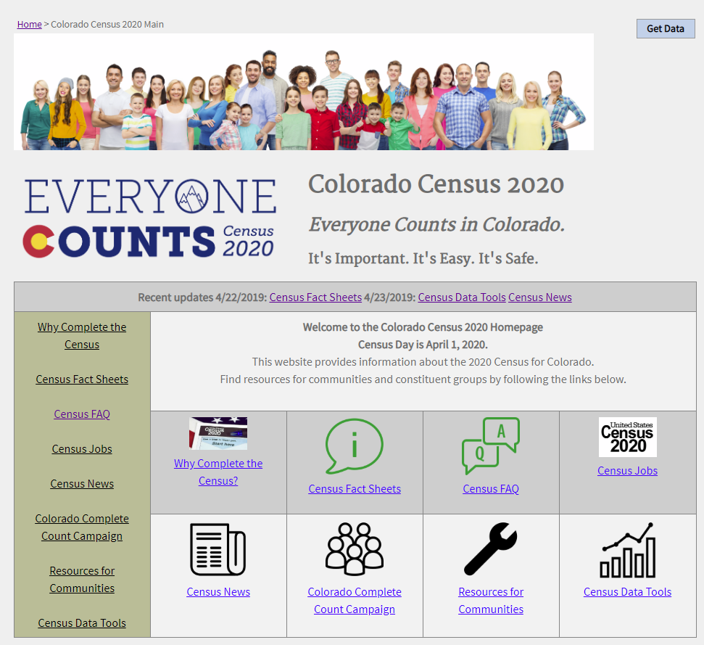
Colorado Census Website
demography.dola.colorado.gov/census_2020/

Slide 25
How to Support the Census
Keep up on Census 2020 by checking out our website.
  www.demography.dola.Colorado.gov/census_2020/
Share information with clients, colleagues, friends.
Provide a link or banner to the 2020 Census on your website.
Launch text message and social media campaigns to educate clients about the 2020 Census.
Include 2020 Census drop-in articles in newsletters.
Inform us about meetings or events where Census 2020 information would be important.
Identify strategies for getting the message out.
Ask your local governments if they are starting a Complete Count Committee or have questions.
Let us know about questions, concerns, ideas.

Slide 26
Planning Timeline
Summer and Fall 2019: Education campaign
Winter 2019 and 2020: Engagement and action campaign
Mid March 2020: Mailing of invitation letters begins
03/23/2020: The count of the population begins online
Mid April: Reminder postcards send to non-respondents
Early May: Non Response Follow Up begins – door to door
August 2020: Data collection ends
12/31/2020: Delivery of counts to the President
04/01/2021: Complete delivery of counts to the states

Slide 27

Colorado Resources
Colorado 2020 Website
  demography.dola.colorado.gov/census_2020/
State Demography Office – Adam Bickford – adam.bickford@state.co.us or 303 864-7753
Census Partnership Coordinator – Lily Griego - Lily.Romero.Griego@2020Census.gov or 303-489-6293

Slide 28
Thank you
State Demography Office
Department of Local Affairs
Elizabeth Garner
Elizabeth.garner@state.co.us
303-864-7750
Demography.dola.colorado.gov

Slide 29
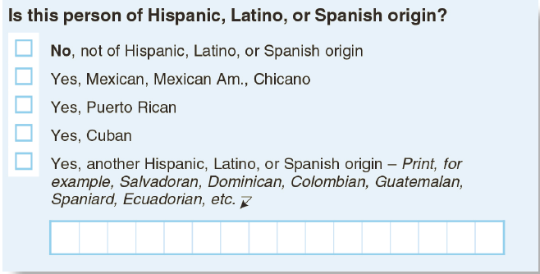
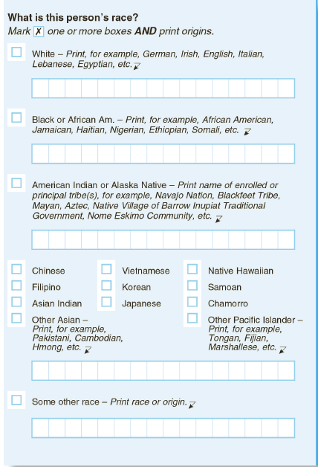
Hispanic Origin and Race
These two questions capture ethnic origins and nationalities
Hispanic Origin is asked separately to satisfy federal program requirements and inform policy research
Respondents can mark multiple races and nationalities

